Slide 1
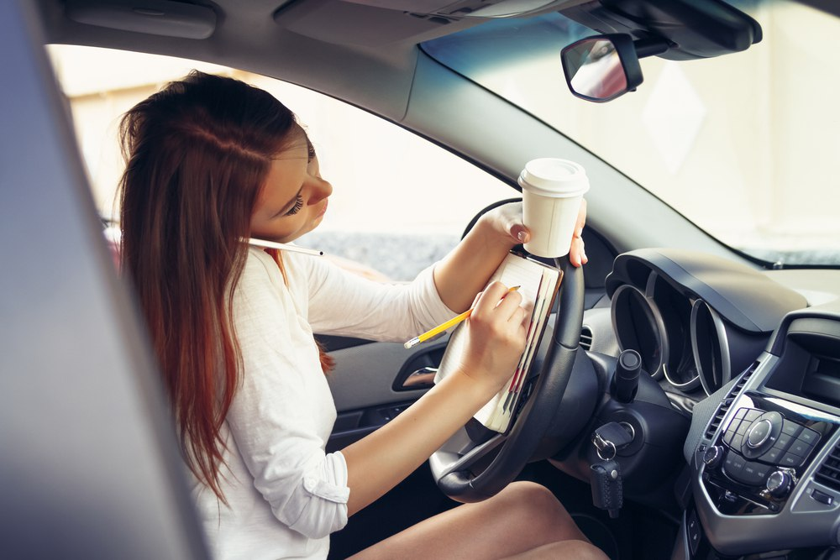
Detection of inattentive drivers Mobile and Social Sensing System A.Y. 2021-22
Giuseppe Cancello Tortora
Mirko Casini
Andrea Lagna
Martina Marino

Slide 2
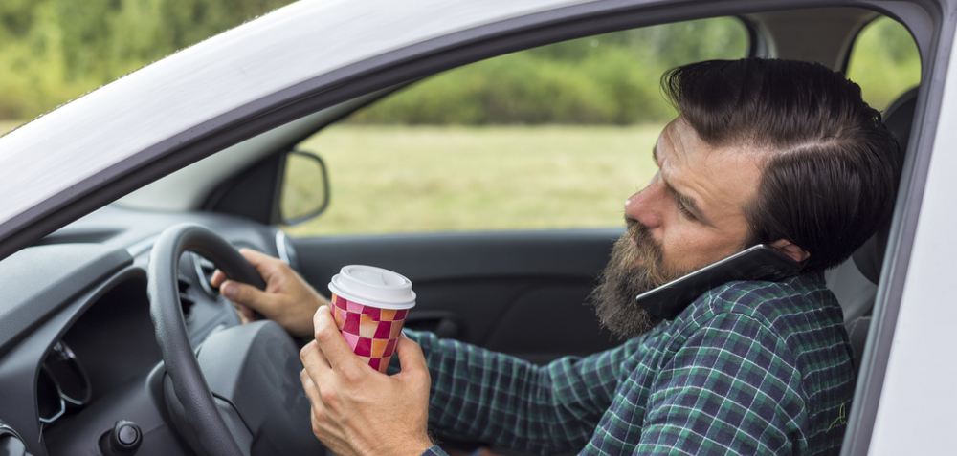

Papers
Driver Distraction Detection Methods: A Literature Review and Framework
Alexey kashevnik, Roman Shchedrin, Christian Kaise, Alexander stocker
Review of the published scientific literature
Driver Distraction Recognition Based on Smartphone Sensor Data
Jie Xie, Allaa R.Hilal, Dana Kulic
A direct research experience
Notes:
The first

Slide 3
Driver Distraction Detection Methods: A Literature Review and Framework
Introduction and motivation
25% of police-reported crashes involve some form of driver inattention such as the driver is distracted, fatigued or lost in thought
Vehicle manufacturers, suppliers, start-ups and researchers are devoting more and more resources to better understand and measure the causes of driver distraction and inattention
Developing of warning and prevention mechanisms for drivers and increasing the automation level of vehicles

Slide 4
Driver Distraction Detection Methods: A Literature Review and Framework
Background
Driver distraction
the diversion of attention away from activities for safe driving toward a competing activity
Types of distraction
Visual distraction
Manual distraction
Cognitive distraction
Auditory distraction
Vocal distraction
Verbal distraction
6 levels of driving automation
No automation
Driver assistance
Partial automation
Conditional automation
High automation
Full automation
Notes:
Despite the increasing automation of driving vehicles, we are so far from the full automation. The major challenge of the actual technology is realizing partial and conditional automation in which role of the human driver as supervisor of the vehicle will be still important for a long time.

Slide 5
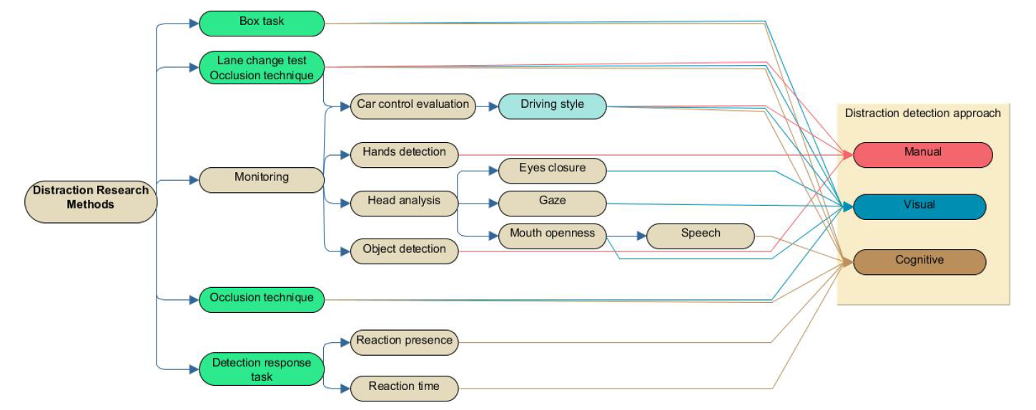
Driver distraction evaluation methods
Driver Distraction Detection Methods: A Literature Review and Framework
Laboratory environment only
Both laboratory and real driving conditions on public roads
Notes:
We can highlight two classes of methods: distraction research and distraction detection
With the second class it is possible to detect the presence of distracting objects (cups, phones, bottles, cigarettes) in the vehicle cabin. Also, estimate the drivers hand positions to detect when the driver is removing hands from steering wheel, perform analysis of eye and gaze behavior as well as head movements, detect talking and analyze emotions in the driver's voice and to evaluate the driving style

Slide 6
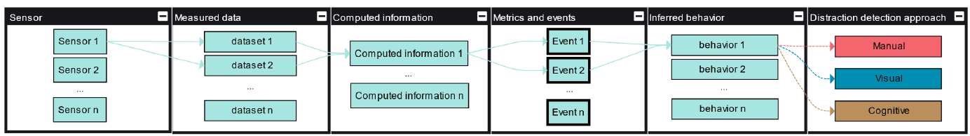
Distraction detection process
Driver Distraction Detection Methods: A Literature Review and Framework
Sensors
Measured data
Computed information
Metrics and events
Inferred behavior
Distraction type
Notes:
The information flow presented in the paper is the following
Allow us to define what distraction type we are observing

Slide 7
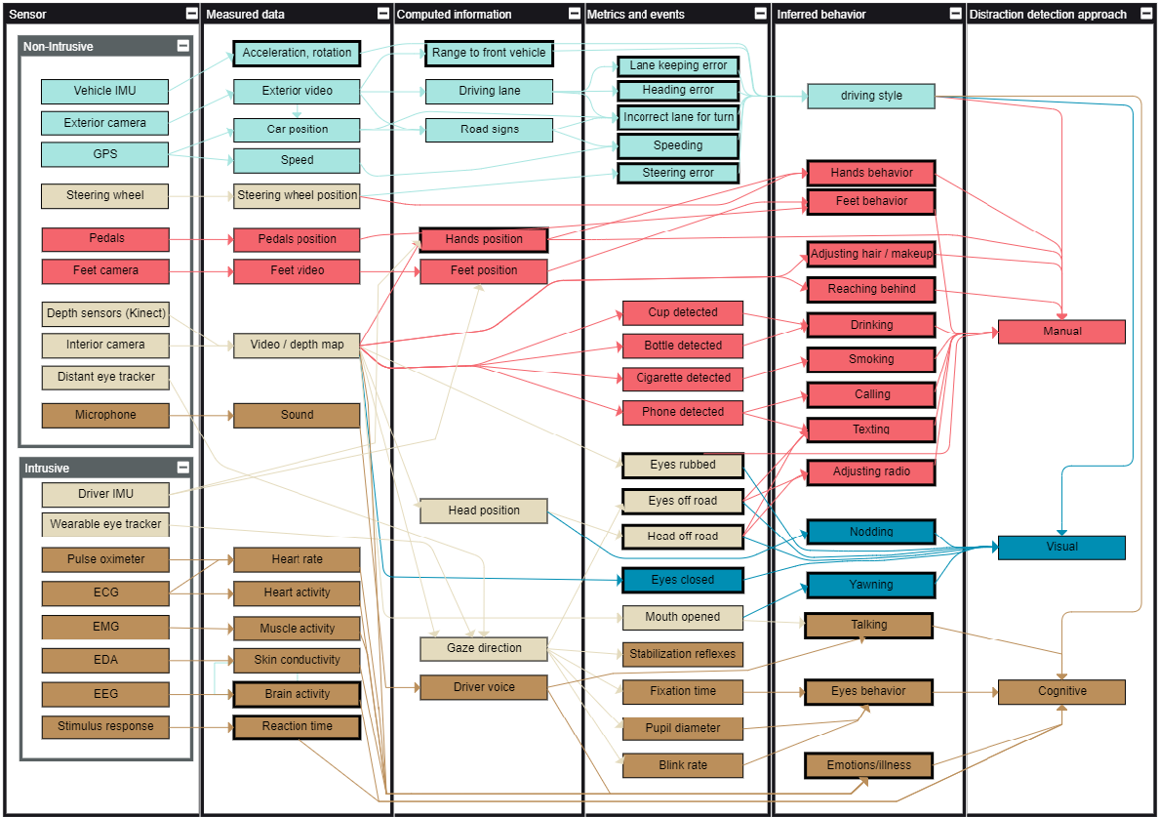
Driver Distraction Detection Methods: A Literature Review and Framework
Notes:
Light brown → multiple final nodes
Light blue → driving style
Red → manual distraction
Blue → visual distraction
Brown → cognitive distraction

Slide 8
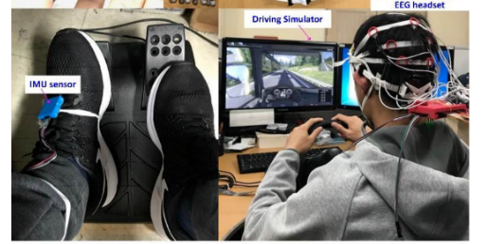
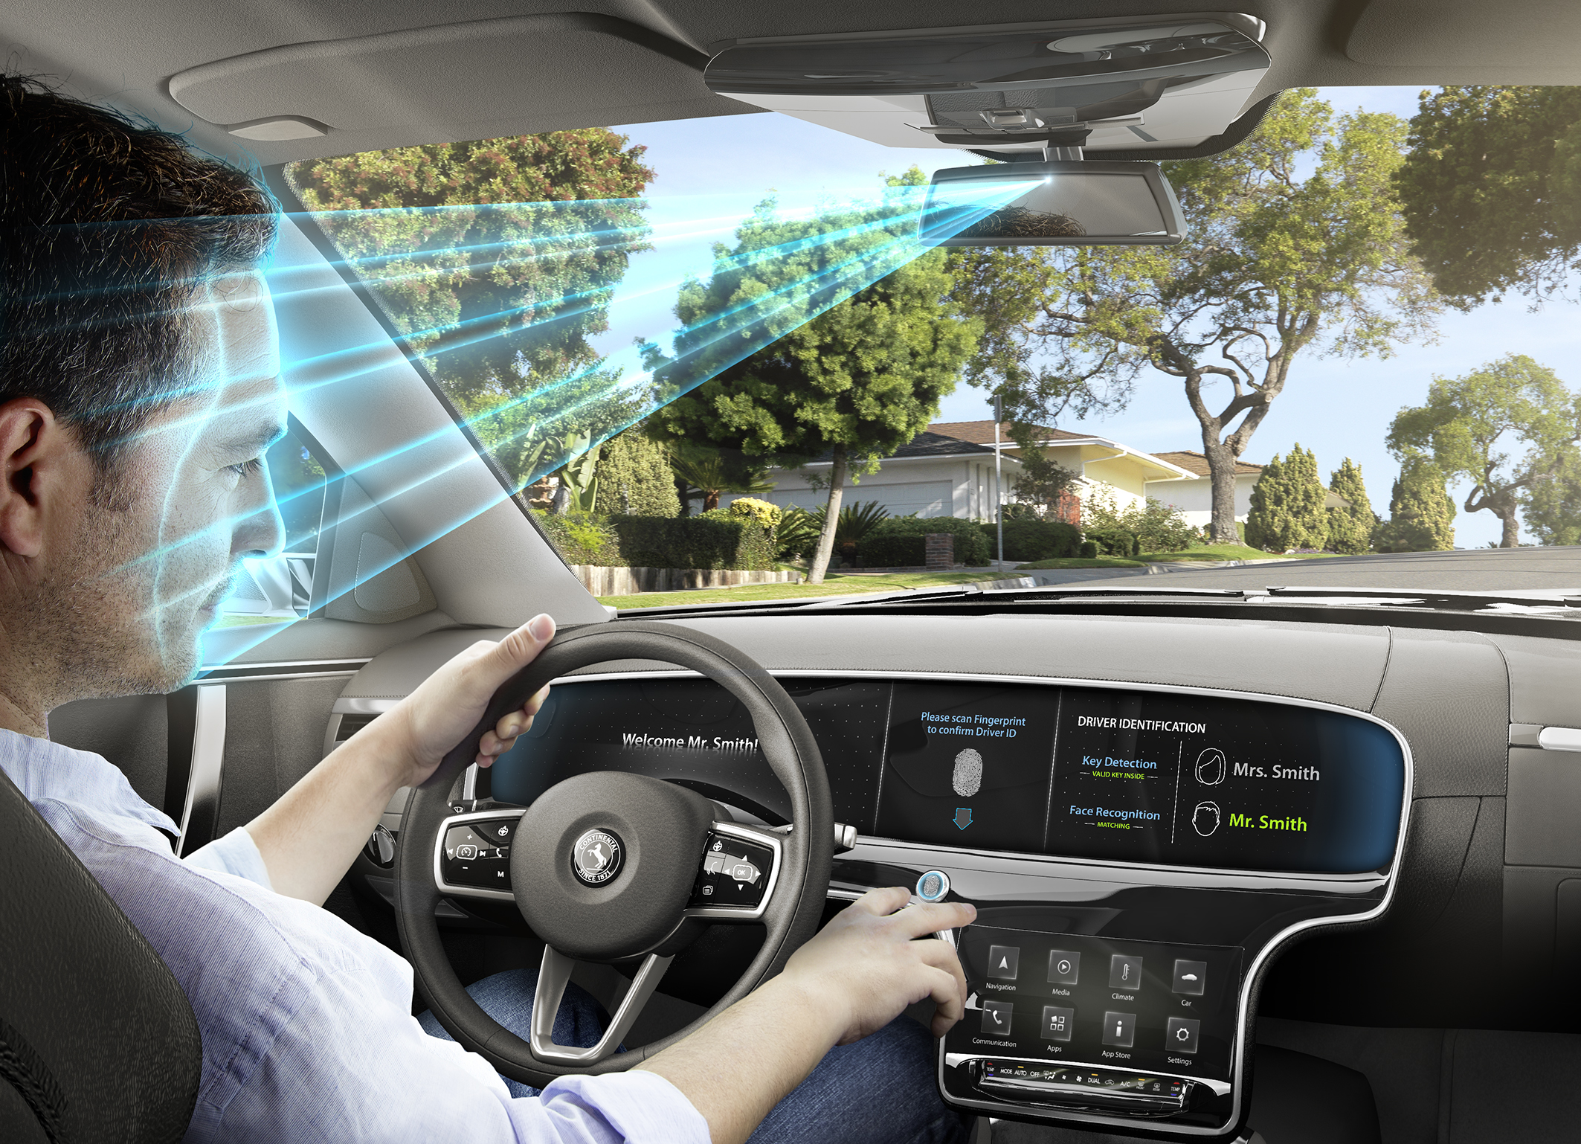
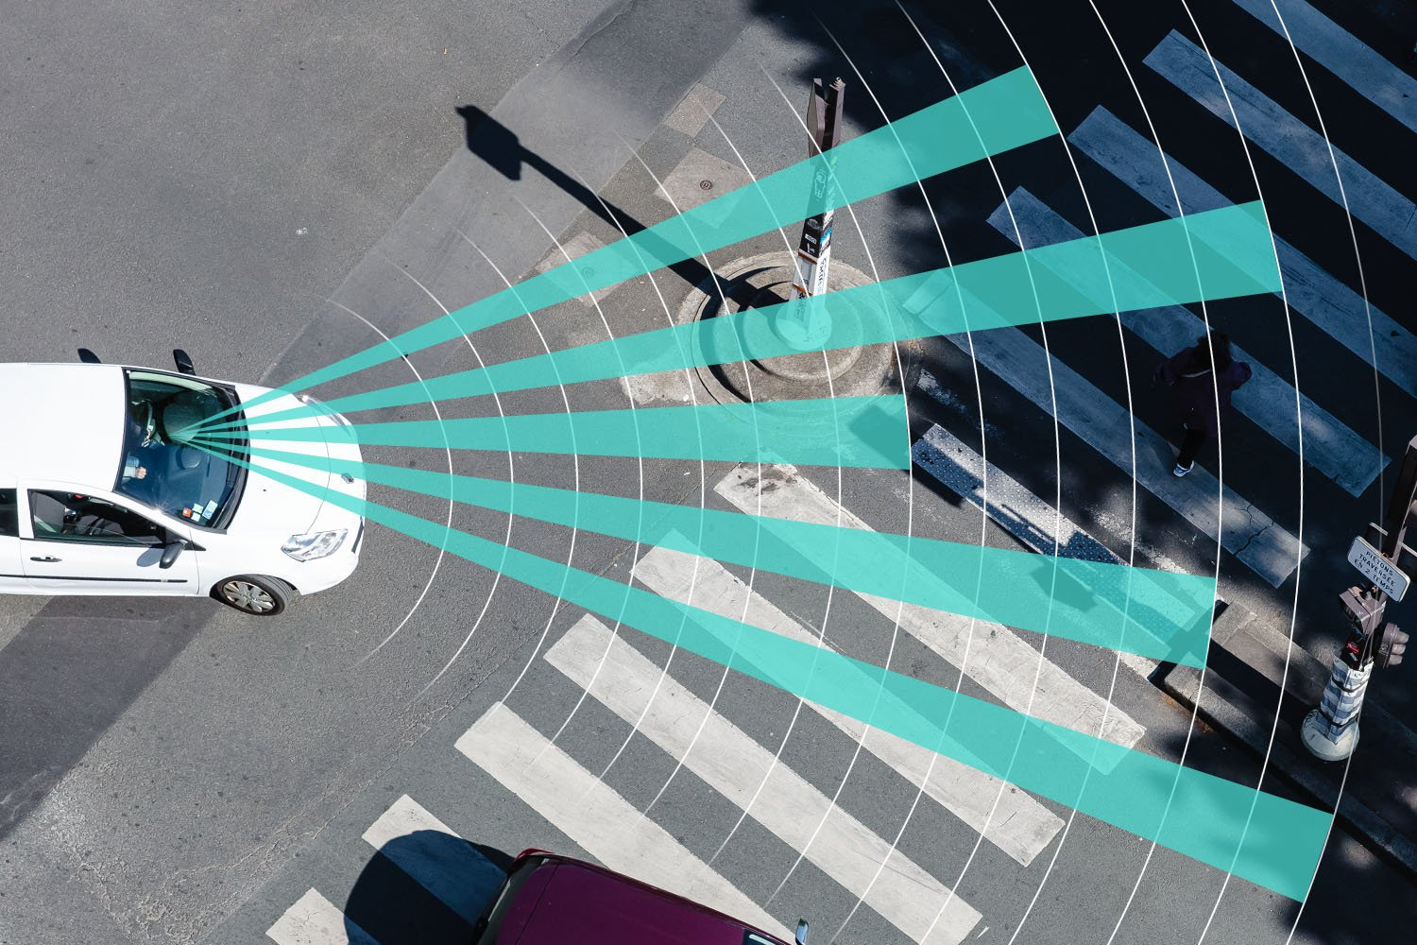
Intrusive VS non-intrusive sensors
Driver Distraction Detection Methods: A Literature Review and Framework
Intrusive sensors
Can obtain more accurate data regarding certain causes of distraction
More useful for research purposes and to collect ground truth
Non-intrusive sensors
Do not distract the driver
Are more adequate for commercial systems
Do not interfere with the movements and poses of the driver
Notes:
Such as electroencephalography
… as they enable the correct differentiation of human cognitive activities for different tasks
Using the intrusive methods are not applicable for the drivers since every time the driver start his/her trip it is uncomfortable to wear some devices.
Ideally, a sensor indicates the level of distraction or the need to focus on the road before the driver feels increased effort or reduced performance.

Slide 9
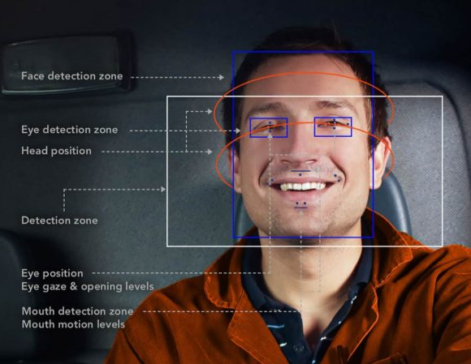

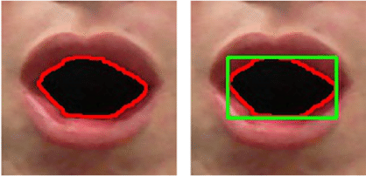
How to detect distraction (non-intrusive sensors)
Driver Distraction Detection Methods: A Literature Review and Framework
1/4
SVM-based algorithms to detect eye closure.
Perspective-N-Points solution combined with RANSAC to analyze head pose.
ML regression algorithms directly on captured image data
Notes:
One example, maybe the simpler, of non-intrusive sensor is the camera. Here we can see how the camera is used to detect the face zone with particular attention on eyes, mouth and head position.
While driving is important to keep your eyes open, also because it’s quite difficult to drive well with your eyes closed, for this some Support Vector Machine algorithm are used to detect eye closure and prevent accident.
Another approach is to use Machine Learning regression algorithms directly on captured image data in order to detect some situation like yawning

Slide 10
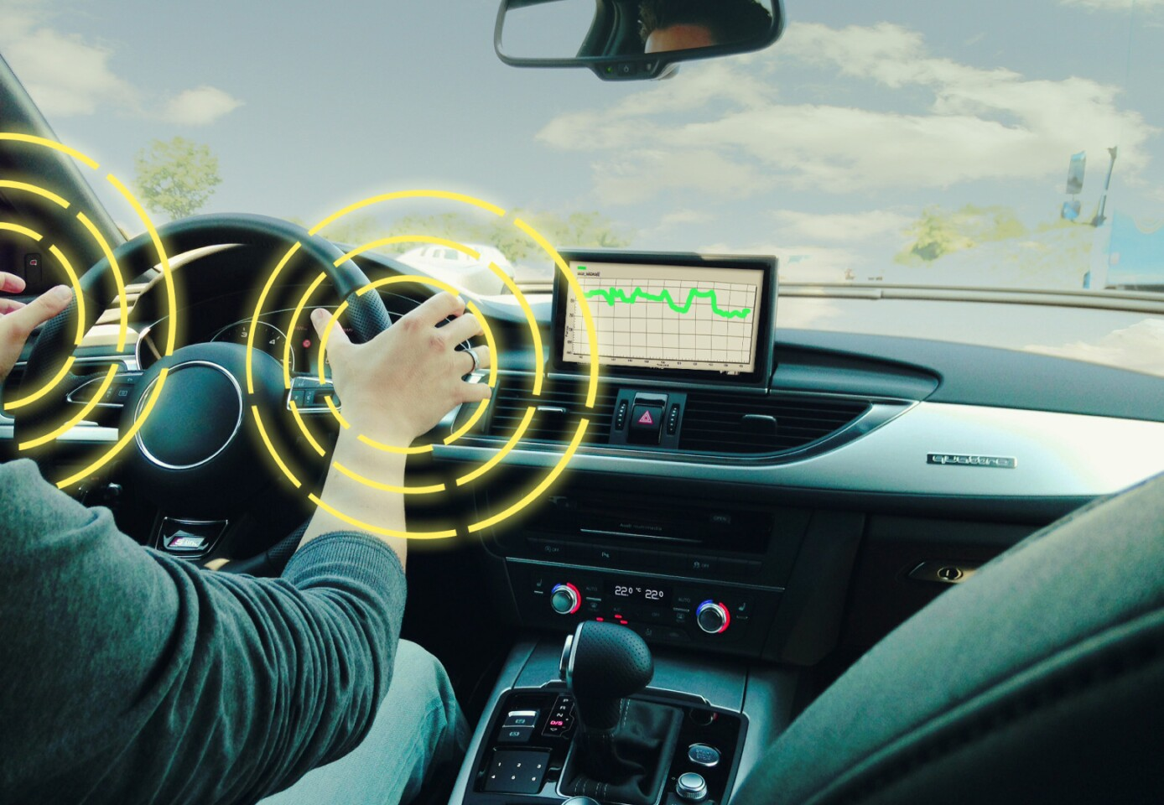
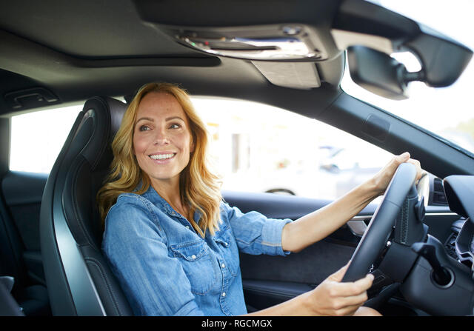
How to detect distraction (non-intrusive sensors)
Driver Distraction Detection Methods: A Literature Review and Framework
2/4
Neural networks or computer vision algorithms used to estimate gaze direction
In case the driver’s hands are not fully captured by the camera AdaBoost classifier should be used
Notes:
The camera can also be used to detect other types of distraction
There are many methods to estimate gaze direction using the images of the eyes. Most accurate methods use neural networks but for rough gaze direction estimation, it is enough to apply simple computer vision algorithms such as pupil position detection.
It is also possible to detect the driver’s hands position using special steering wheel or cameras, in case the driver’s hands are not fully captured by the camera, their positions can still be indirectly estimated by analyzing the positions of the visible parts of the arms in addition to a classifier like AdaBoost

Slide 11
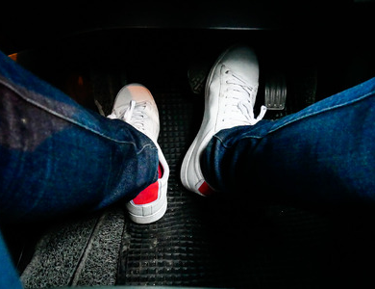
How to detect distraction (non-intrusive sensors)
Driver Distraction Detection Methods: A Literature Review and Framework
3/4
Features extracted from optical flow can be passed to a Hidden Markov Model (HMM) and argue that this might help to predict pedal misapplications
Notes:
Other types of cameras can be used for driver monitoring
feet-looking camera can be used to analyze feet behaviour. For example, using a feet looking camera could be useful to predict pedal applications even before they happen
Thereby features extracted form optical flow can be passe to Hidden Markov Model to detect and predict pedal misapplications such as situations when the driver intended to press one pedal but pressed another pedal

Slide 12



Driver Distraction Detection Methods: A Literature Review and Framework
How to detect distraction (non-intrusive sensors)
4/4
Training a ML algorithm on MelFrequency Cepstral Coefficients features (but other features and approaches can also be used)
Notes:
The microphone is another non-intrusive sensors that will help in distraction detection.
Researchers have even extract emotions from the captured voices of vehicle drivers. Usually, it is performed by training a machine learning algorithm on Mel Frequency Cepstral Coefficients (MFCC) features.
Another useful metric is the voiced/unvoiced ratio that can help to evaluate the driver’s fatigue.
The microphone also allows to detect the presence of music in the car.

Slide 13
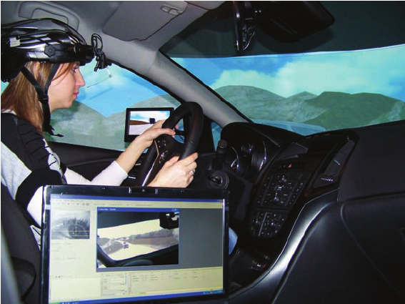
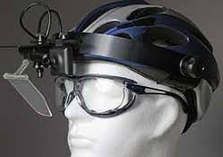
How to detect distraction (intrusive sensors)
Driver Distraction Detection Methods: A Literature Review and Framework
It is also possible to evaluate a lot of aspects from analyzing the eye behaviour while driving in different conditions.
Notes:
Let’s now consider an example of an intrusive sensor: a special eye tracker that allow evaluating gaze direction with higher precision than cameras.
Eye trackers can be worn on the head and allows estimating a particular spot, at which the driver is looking, allowing an estimation, how much attention the driver gives to road signs, other vehicles, and pedestrians.
It is also possible to evaluate other aspects from analyzing the eye behaviour:
Increased cognitive workload leads to increased pupil
increased blink rate
decreased mean relative fixation time

Slide 14
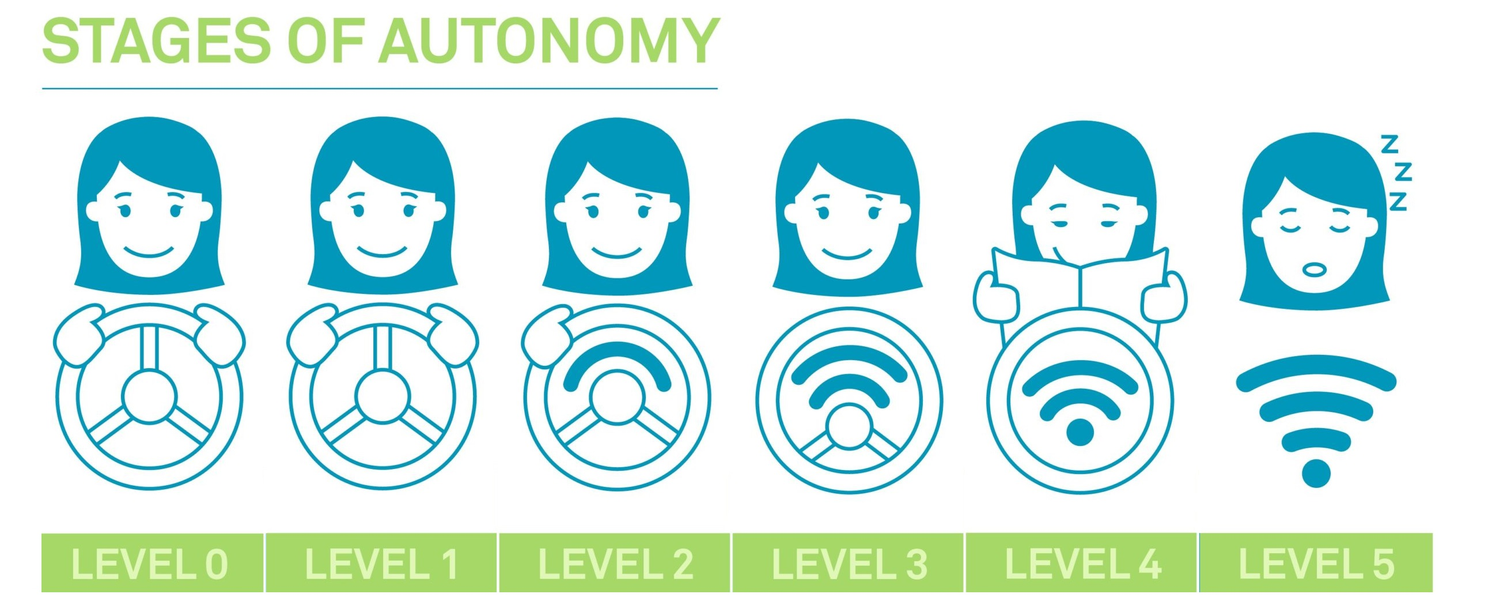
Conclusions
Driver Distraction Detection Methods: A Literature Review and Framework
Drivers will still have to be attentive
Vehicle manufacturers will expand sensors technologies for a better interpretation of vehicle external and internal environment
Distraction detection systems will be more and more important both if the autonoumous level increase or decrease
Notes:
We point out that despite the increasing automation of the vehicle, the human driver will still play a role as supervisor of the automation, the driver needs at least a minimum of attention to keep the car and the drive in good conditions
it is expected that vehicle manufacturers will expand their sensor technology not only in terms of a better interpretation of the vehicle environment but also for better interpretation of the vehicle interior to detect possible distractions
In conclusion the distraction detection system will play an important role both if the autonomous level of driving increase or decrease in the next years

Slide 15
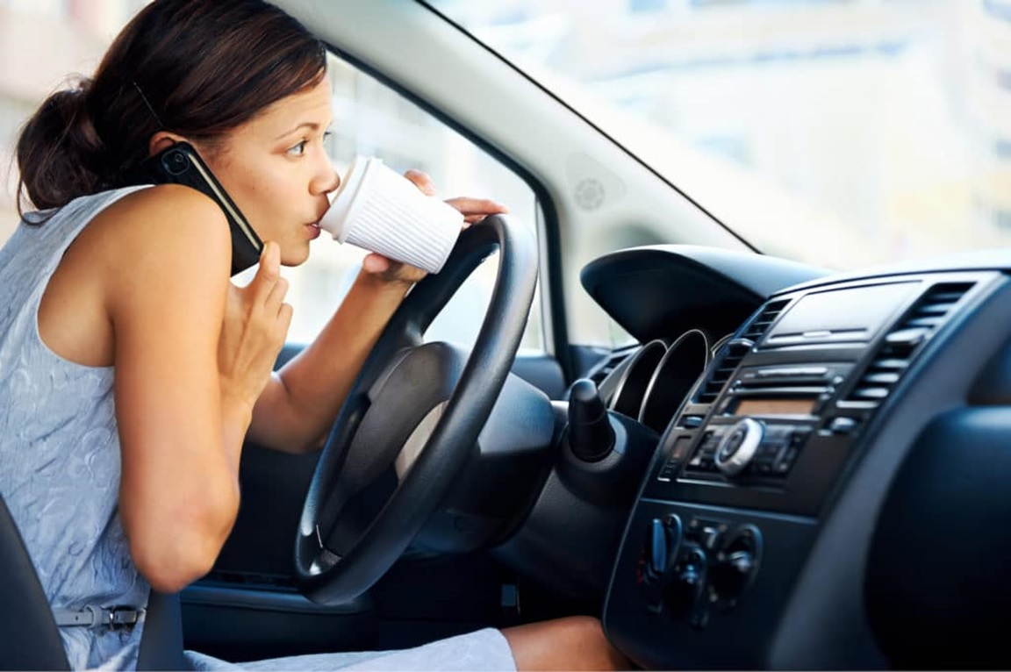
Papers
Driver Distraction Detection Methods: A Literature Review and Framework
Alexey kashevnik, Roman Shchedrin, Christian Kaise, Alexander stocker
Review of the published scientific literature
Driver Distraction Recognition Based on Smartphone Sensor Data
Jie Xie, Allaa R.Hilal, Dana Kulic
A direct research experience

Slide 16
Introduction
Driver Distraction Recognition Based on Smartphone Sensor Data
Driver distraction is one of the leading causes of vehicle accidents and injury
24 drivers between 21 and 52 yo were recruited to participate, driving on a route consisting of suburban and highway driving.
The study develops a smartphone sensor based driver distraction system using an ensemble learning method.
Study
Experiment

Slide 17




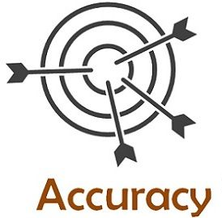

Previous studies
Driver Distraction Recognition Based on Smartphone Sensor Data
Detection of driver cognitive distraction at stop-controlled intersection by using a driving simulator for collecting data
3 types of features: scenario-based, sensor-based and eye-movement features.
LIMITS OF THESE STUDIES:
Only video data for driver distraction recognition
Limitated usability while driving at night
Privacy issue

Slide 18




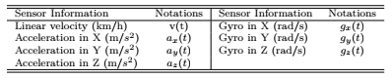
Objective of this work
Driver Distraction Recognition Based on Smartphone Sensor Data
Estimate driver distraction from the driver’s mobile device, using only motion data collected by the IMU and GPS sensors.
DATA COLLECTION
INTERPOLATION AND NOISE REDUCTION
SIGNAL FEATURES
SLIDING WINDOW FOR FEATURE EXTRACTION
Mean, variance, median, range, kurtosis, skewness, root-mean-square
Notes:
Non so niente

Slide 19

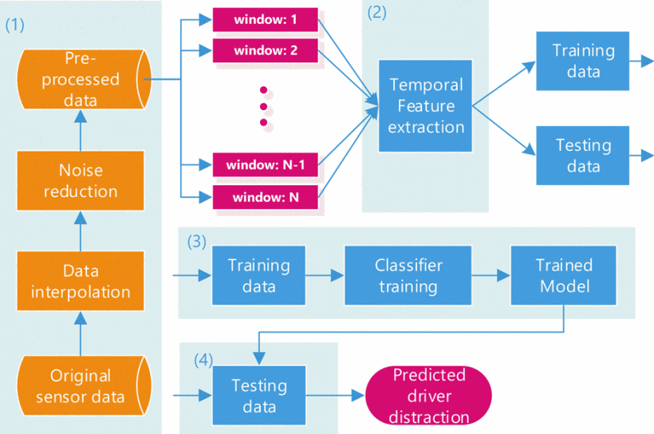
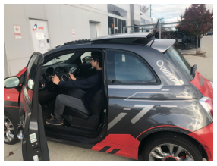
Pipeline
Driver Distraction Recognition Based on Smartphone Sensor Data
Driver distraction recognition system consists of 4 steps:
IMU sampling rate: 100 Hz
Linear velocity (from GPS) sampling rate: 1 Hz
3 road conditions:
Parking lot
Highway
City road

Slide 20
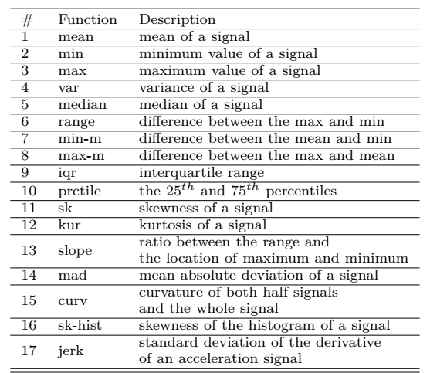
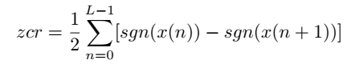
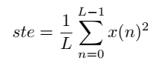
Feature extraction
Driver Distraction Recognition Based on Smartphone Sensor Data
Before feature extraction, noise reduction is applied:
moving median (outlier removal from signal) filter
moving mean (smoothing filtered signal) filter
For each sliding window, 19 temporal features were considered:
18) zero-crossing rate:
19) short-time energy:

Slide 21
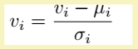
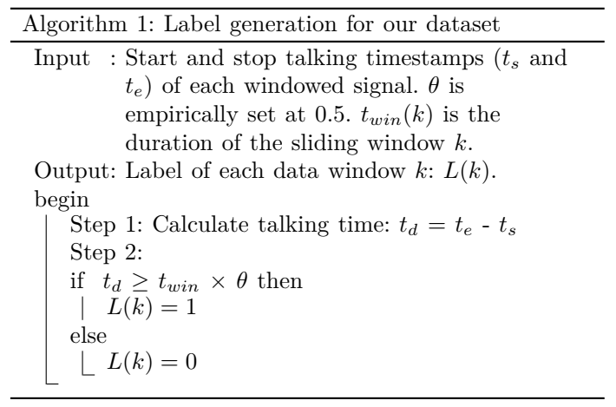
Label generations for dataset
Driver Distraction Recognition Based on Smartphone Sensor Data
After feature extraction, all features are concatenated together to form a feature vector of dimension 273.
Then, the normalization is conducted as follows:

Slide 22

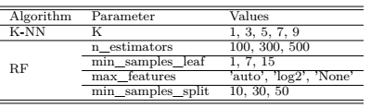
Classification
Driver Distraction Recognition Based on Smartphone Sensor Data
4 standard classifiers:
K-NN
Logistic Regression
Ensemble learning:
Returns labels as argmax of the sum of predicted probabilities
Naive-Bayes
Random Forest
GridSearch is used to optimize the parameters using 5-fold-cross-validation.
Notes:
4 standard classifiers (k-nn: distance between feature vectors, LR: logistic functions, NB: posterior probability, RF: tree-based )
Ensemble: a combination of the classifiers often achieves better results by assigning weights to the results of different individual classifiers.
Grid search + parameters

Slide 23
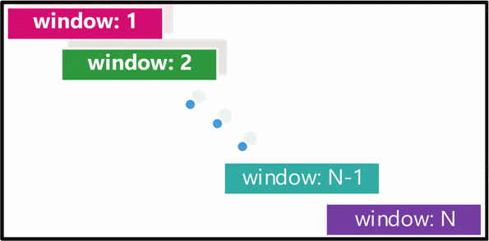

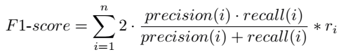
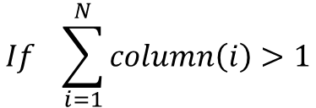
Evaluation
Driver Distraction Recognition Based on Smartphone Sensor Data
For each classifier output, a label is assigned to each sliding window that is re-converted back to sample labels for the evaluation.
$$If \sum_{i=1}^{N}{column\left(i\right)>1}$$
DISTRACTED DRIVING
The proposed system is evaluated using a weighted F1-score, defined as follows:
Notes:
Each column of the matrix is one sample
Ri -> ratio between the number of samples of one class and the total number of samples in all classes

Slide 24
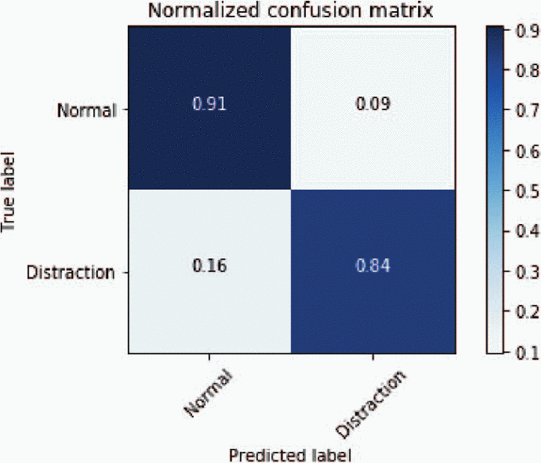
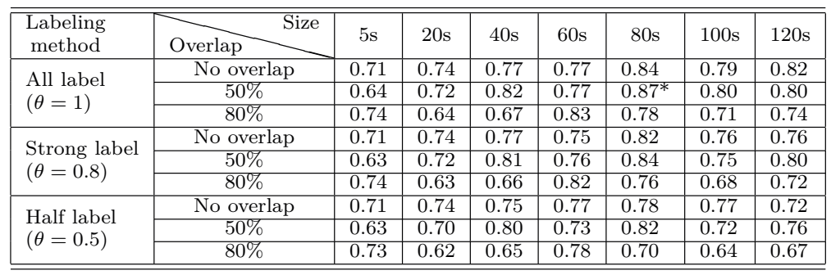
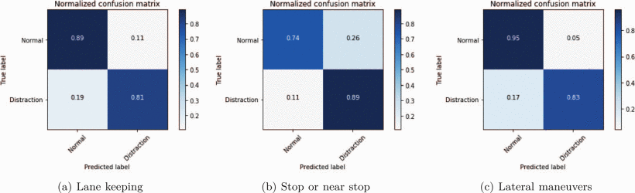
Results (1/2)
Driver Distraction Recognition Based on Smartphone Sensor Data
F1-score:
74.3%
83.8%
87.3%
Notes:
Distraction samples are more easily misclassified then normal samples
Overlap 50%: same maneuver will belong to different windows using a bigger overlap, no overlap = no important pattern of distraction
Window size 60-80s: small window => cannot capture sufficient info to represent distraction pattern, big window => more than one class in a window
Lateral maneuver F1 score is higher because both turning and lane changes are more likely to be affected when the driver is distracted
Model based on IMU and GPS -> lower performance when stopping or near stopping beacuse the signal are not changing in those cases

Slide 25
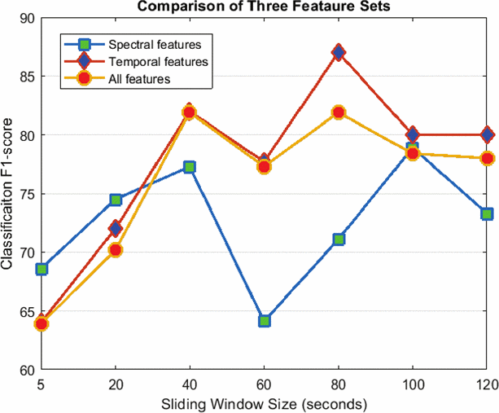
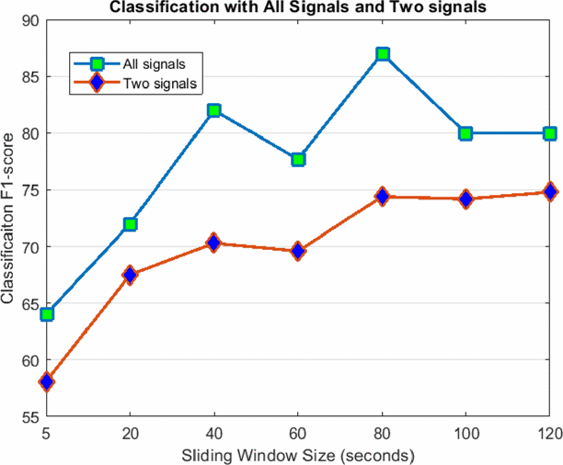
Results (2/2)
Driver Distraction Recognition Based on Smartphone Sensor Data
v(t) and g_{z}(t) -> most important signals
min, mean-min and median -> most important features
Notes:
Spectral features -> frequency domain but not improve, also considering all the features together
Random forest to select the 2 most important signals: linear velocity and z-axis gyroscope with min, mean-min and median the most important features
Min and mean-min of gz(t)-> capture vehicle shifting,
Min mean-min and median of v(t) may detect erratic braking
Worse classification with only 2 signals

Slide 26
Conclusions
Driver Distraction Recognition Based on Smartphone Sensor Data
Driver cognitive distraction recognition systems relying only on the mobile phone was developed, which do not require viewing the driver or knowing the driver or the outside conditions.
Do not need to perform maneuver detection, but performance is improved when the driver is performing more difficult maneuver.
Only one cognitive distraction is tested by talking to the passenger while driving.

Slide 27
THANK YOU FOR
THE ATTENTION
Any questions?

